Slide 1
Lecture 31 November 20th , 2019
Thursday will be an independent opportunity to analyze F2 flies. I will help get organized so that each lab will have flies to analyze if possible.
Thursday---I will be here for the morning lab, but not the afternoon.
Everyone should put in 1-hour of analysis on Thursday—before 3 pm, if possible.

Slide 2
Thursday
All GFP papers due at noon or before—make arrangements if you have a noon class to turn it in-- in Swain 304, Thursday.

Slide 3
Exam 3 will be proctored by Dr. Lepp or Dr. Halloran Friday.
Please be helpful if they have questions.
No class Monday (I’m out of town)—so no class/lab next week! No lecture online. Just a day off. ☺

Slide 4
Where were we?
Hopefully you’ve practiced some 3 point mapping and tried text problems?
Questions?
We left off with the concept of interference.

Slide 5
In the map of corn genes
v
pr
bm
22.3 cM
43.4 cM
What was the expected frequency of DCO?
(0.223)(0.434) =0.097
9.7% IF….crossover in one interval does not interfere with or enhance crossover in an adjacent interval.....

Slide 6
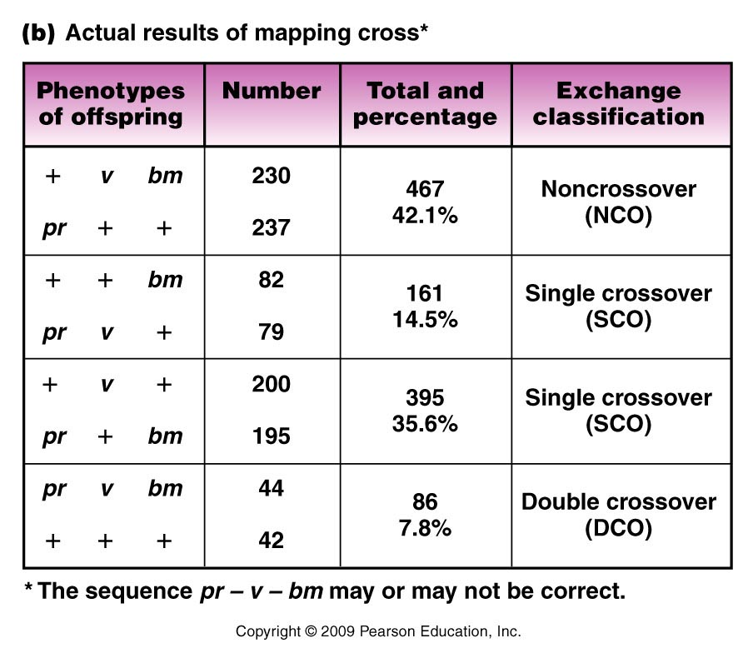
Which classes appear to be NCO?
Which classes appear to be DCO?
Figure 5.10b
Notes:
6
Figure 5-10b (a) Some possible allele arrangements and gene sequences in a heterozygous female. The data from a three-point mapping cross, depicted in (b), where the female is testcrossed, provide the basis for determining which combination of arrangement and sequence is correct. [See Figure 5–11(d).]

Slide 7
Observed DCO? 7.8%
Example in which we assume that X.O in one region affected (in this case, inhibited) X.O. in an adjacent region.
Called: INTERFERENCE

Slide 8
We can quantify interference:
1. determine Coefficient of coincidence
C = observed DCO
expected DCO
C=7.8/9.7= 0.80 (Only 80% of expected DCO occurred)
C=1 Observed DCO = expected DCO
C<1 fewer DCO than expected
C>1 more DCO than expected

Slide 9
From our example
Interference (I)=1-C
I=1-.80=0.20 (20% interference)
C=1 I=0 no interference
C<1 I>0 positive interference
C>1 1<0 negative interference

Slide 10
Be sure you review recombination mapping, 3-point mapping, interference.
Problem sets 3 and 4(linkage) is posted on website.
You are expected to understand the book’s examples in chapter 5. Practice analyzing data from 3-point crosses.
The F2 flies that emerge from your F1 X F1 crosses will give you real data for mapping cv, y, and f.

Slide 11
Returning to Nucleic acid chemistry…
Nucleic acids----DNA and RNA
Both are polymers (repeating units) of nucleotides.

Slide 12
Nucleotides…
3 components
5-carbon (pentose) sugar
Nitrogenous base
PO₄ group(s)
1 PO₄ group =nucleoside monophosphate
2 PO₄ groups =nucleoside diphosphate
3 PO₄ groups =nucleoside triphosphate
Nucleoside

Slide 13
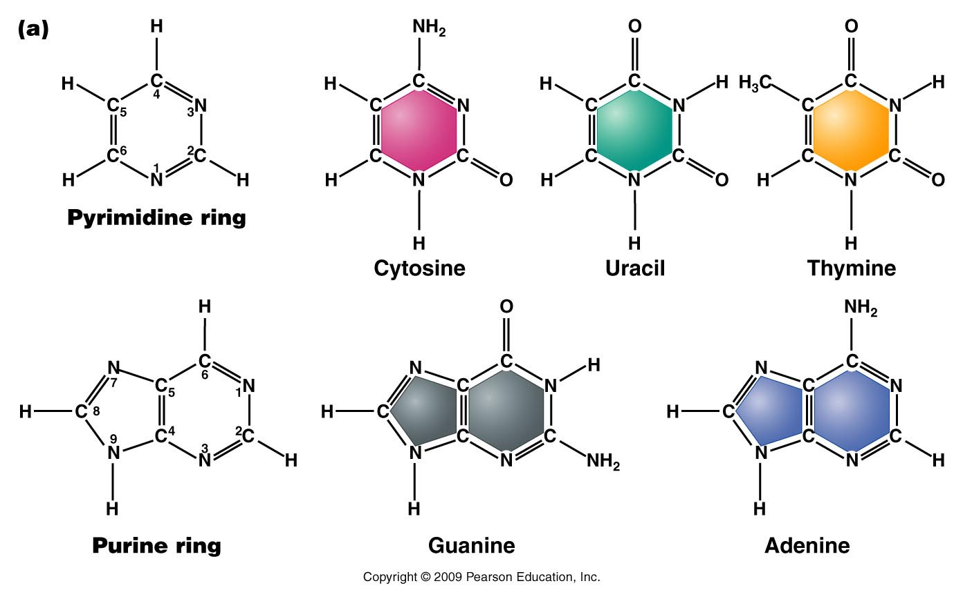
The bases---Do not memorize atomic structure but recognize pyrimidine vs. purine—note all contain nitrogen.
The nitrogen and carbon atoms are numbered.
Figure 10.9a
Notes:
Figure 10-9a (a) Chemical structures of the pyrimidines and purines that serve as the nitrogenous bases in RNA and DNA. The nomenclature for numbering carbon and nitrogen atoms making up the two bases is shown within the structures that appear on the left. (b) Chemical ring structures of ribose and 2-deoxyribose, which serve as the pentose sugars in RNA and DNA, respectively.Web Tutorial 10.1DNA Structure

Slide 14
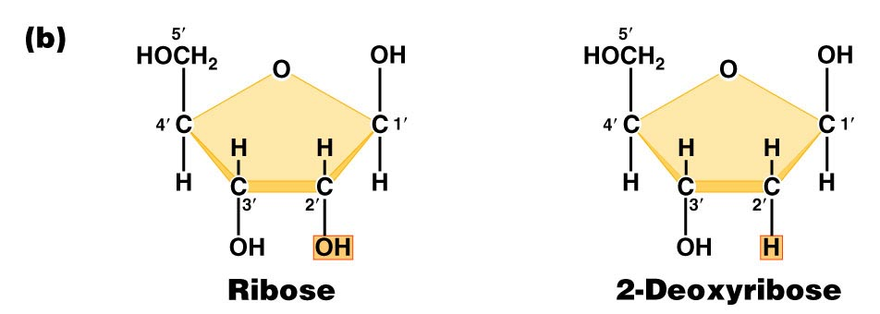
Pentose sugars in RNA and DNA
DRAW THEM!! Note the numbering of atoms
(1’, 2’….carbons).
Found in RNA
Found in DNA
Figure 10.9b
Notes:
Figure 10-9b (a) Chemical structures of the pyrimidines and purines that serve as the nitrogenous bases in RNA and DNA. The nomenclature for numbering carbon and nitrogen atoms making up the two bases is shown within the structures that appear on the left. (b) Chemical ring structures of ribose and 2-deoxyribose, which serve as the pentose sugars in RNA and DNA, respectively.Web Tutorial 10.1DNA Structure

Slide 15
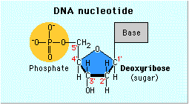
Sketch a nucleotide—show this level of detail
Need not show atomic detail of all bases
Need to show carbon numbering of the sugar
Phosphate groups
Thymine

Slide 16
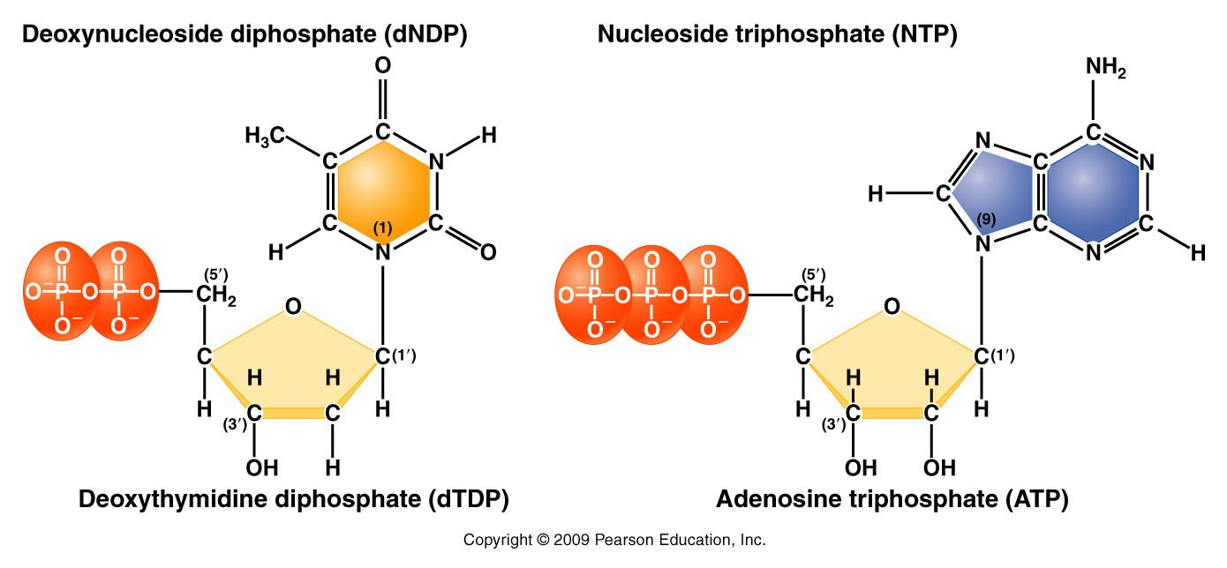
Complete structure of nucleotides
Nitrogenous base forms bond with the 1’ carbon of the sugar
Phosphate forms bond with the 5’carbon of the sugar
Figure 10.11
d=deoxyribose
no “d”= ribose
Notes:
Figure 10-11 Basic structures of nucleoside diphosphates and triphosphates, as illustrated by deoxythymidine diphosphate and deoxyadenosine triphosphate

Slide 17
When talking about any or all RNA or DNA building blocks we us “N” to designate any/all of the bases.
For example, dNTP—could be dATP, dCTP, dTTP, or dGTP. If dNPT is plural (dNTPs), we are referring to all 4 DNA nucleotides.

Slide 18
Be sure you can….
Recognize small differences in structure/chemical make up!
Be sure to be able to distinguish between:
dNTPs and NTPs
dNMPs, dNDPs, dNTPs
Be able to recognize a stretch of RNA from a single strand of DNA….

Slide 19
By the way….Nucleotides serve various functions
Nucleic acid (RNA and DNA) building blocks* (our focus here)
Energy molecules (ATP/GTP)
Signaling molecules (cAMP)

Slide 20
DNA/RNA made of chemically linked nucleotides
Specific type of linkage joins adjacent nucleotides
5’ carbon of one nucleotide forms a linkage to the 3’ carbon of the adjacent nucleotide
Phosphate links 2 nucleotides in a phophodiester bond

Slide 21
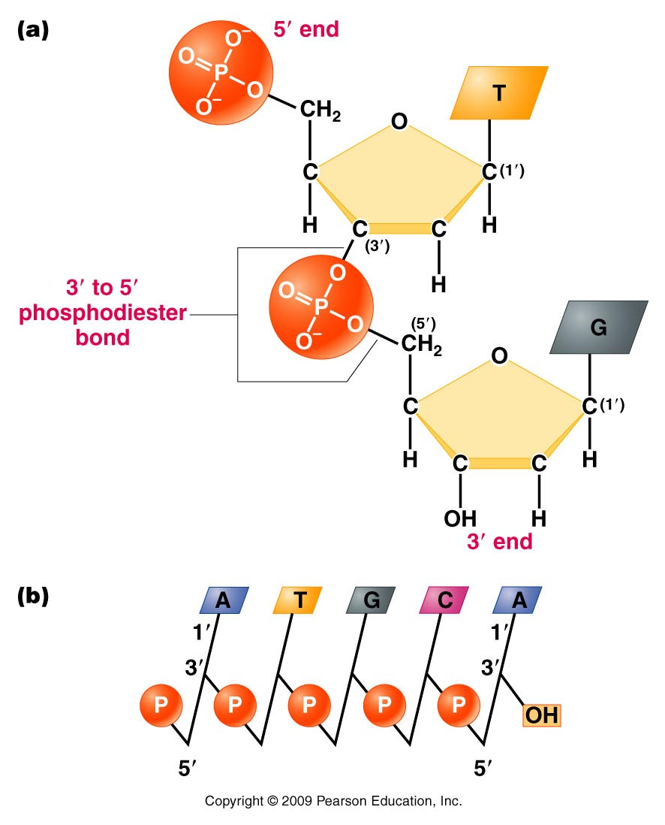
Result is a 5’-3’ linkage and a molecule with 5’ and 3’ ends.
A strand of DNA/RNA
Figure 10.12
Notes:
Figure 10-12 (a) Linkage of two nucleotides by the formation of a C-3’ –C-5’ (3’ –5’) phosphodiester bond, producing a dinucleotide. (b) Shorthand notation for a polynucleotide chain.

Slide 22
RNA exists as a single strand* of nucleotides
DNA is a double strand of nucleotides
Strands are connected via non-covalent bonds between specific bases.
Adenine bonds to Thymine
Cytosine bonds to Guanine
* adenine and uracil (and cytosine and guanine) can form bonds in regions of an RNA single strand or in DNA-RNA hybrids.
Complementary base pairing

Slide 23
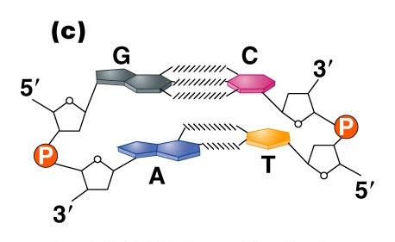
Figure 10.14c
Notes:
Figure 10_14c (a) The DNA double helix as proposed by Watson and Crick. The ribbonlike strands constitute the sugar-phosphate backbones, and the horizontal rungs constitute the nitrogenous base pairs, of which there are 10 per complete turn. The major and minor grooves are apparent. The solid vertical bar represents the central axis. (b) A detailed view depicting the bases, sugars, phosphates, and hydrogen bonds of the helix. (c) A demonstration of the antiparallel nature of the helix and the horizontal stacking of the bases.

Slide 24
Complementary base pairing requires the DNA strands run in opposite directions with respect to 5’ and 3’ ends. (Antiparallel strands)
Complementary base pairing is only possible with a slight twist to each successive base pair. The twisting to accommodate pairing, creates the helical molecule.

Slide 25
(How do we know)? Determining DNA structure…
Double helix is 63 years old!! (knowledge of DNA structure) Published April 25th, 1953.
Watson JD. Crick FHC. A structure for deoxyribose nucleic acid. 1953; Nature 171:737-8.
Watson and Crick got most of the glory…but the discovery of the structure was a very much a group effort.

Slide 26
It began with biochemical studies…
Erwin Chargaff—studied DNA by base composition.
Noted roughly equal concentrations of:
Purines and Pyrimidines
Specifically: [A] = [T] and [C] =[G]

Slide 27
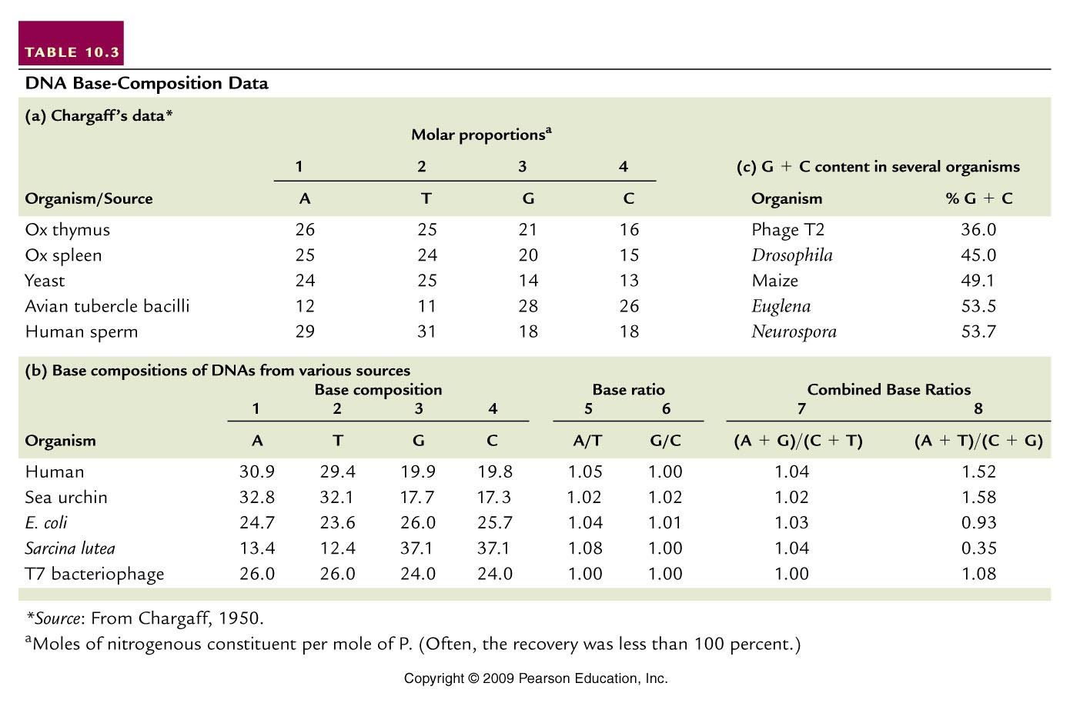
(purines=pyrimidines)
(A+T not = G +C)
Table 10.3
Notes:
Table 10.3 DNA Base Composition Data

Slide 28
Suggested 1:1 interactions of specific bases.
A-T and G-C
Eventually this biochemical ratio supported the specific A-T and G-C base-pairing scheme which facilitates the interaction of 2 DNA strands.

Slide 29
Interestingly---different species have different base compositions---Some are more A/T rich some are more G/C rich.
Humans have more A-T base-pairs than G-C base pairs.
A bacterial species—Sarcinia lutea has more G-C than A-T base pairs.

Slide 30
(purines=pyrimidines)
(A+T not = G +C)
Table 10.3
Notes:
Table 10.3 DNA Base Composition Data

